Slide 1

Covering Coverage
Data Engineering Project
Building a pipeline of Catalonian cell network API data

Slide 2

Background & Motivation
Popular region with lots of tourism
Majority of population is connected to the network
Need a site to monitor outages, performance, and changes.
Notes:
The Catalonia region of northeastern Spain is a travel destination for close to 6 million tourists per year, as well as a home to 7.5 million people.
97% of households use mobile telephones, as do virtually all tourists.
Visitors, residents, and government officials alike need a site to monitor cell service outages, performance, and changes. This gives:
clues about if poor performance is an individual or network problem,
advice on which networks are the best or worst,
and a better understanding overall of how the systems operate.
Sister went recently for honeymoon, and would be curious about signal if I visit myself

Slide 3
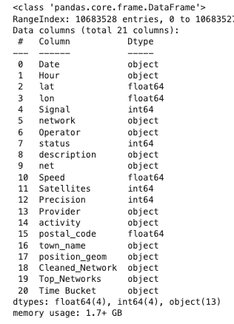
Data & Methods
Catalonian Cell Coverage from Google BigQuery’s API
11,000,000+ rows,
each representing a carrier’s coverage status at a specific date, time, and place.
The categorical groups examined will be for:
Network operators
Activity
Notes:
The dataset used was Catalonian Cell Coverage from Google BigQuery’s API.
There are 11,000,000+ rows, each representing a carrier’s coverage status at a specific date, time, and place.
Rows with missing values in the categories or target fields were removed.
The categorical groups examined will be for:
Network operators
Since the top 4 make up almost 99% of carriers used (Movistar, Orange, Vodafone, and Yoigo), all others will be grouped together as “Other”.
Activity
Designates if a cell phone is being used while the person is stationary, in a car, or on a bike.

Slide 4
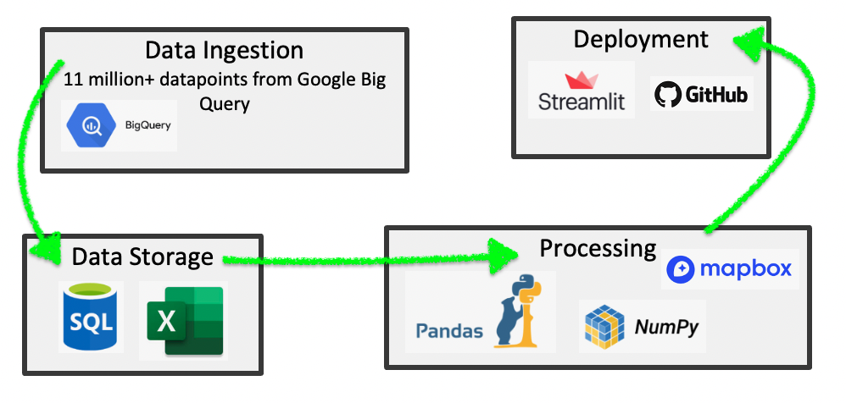
Pipeline
Notes:
SQL was used in the Google BigQuery API interface to export smaller chunks of about 1,000,000 rows each into individual, manageable .csv files.
Pandas combined the .csv files into one database, which was loaded into SQL for storage and querying.
Since processing the entire file was time-consuming, numpy split it into smaller dataframes for testing & deployment.
Matplotlib was the basis of chart creation.
Pandas’ value_count() feature was the basis of the pie charts for the categorical fields.
Histograms were created to view the speed, precision, and accuracy by carrier or activity based on the chosen time period.
Mapbox was used to create the map to see which spots had the most activity or network usage.

Slide 5

Results
Streamlit App Link:
http://192.168.1.239:8501
Notes:
Source: https://www.qr-code-generator.com/

Slide 6
Conclusion & Future Work
Try Spark to process data more quickly.
Find API with live updates & create connection.

